Slide 1
Building Android apps – Week 3b
2843-201710_MCS4993_M:Topics in MA/CS
2843-201710_MCS5993_M:Topics in Computer Science

Slide 2
Agenda
Chapter 5 HFAD – Views (Linear and Grid Layouts)
Chapter 6 HFAD – List Views and Adapters
Notes:
Going to finish off the Views chapter and then start on the List Views.

Slide 3
Assignment
Chapter 2 HFAD – BookWorld Github (due Tuesday)
Choose book categories, fiction, non-fiction, horror, drama and display different books for each category – use BeerAdviser code
Chapter 3 HFAD – Get Intent code example working (due Thursday)
Read Chapter 5

Slide 4
Chap 5 – Linear Layout
Notes:
A linear layout displays its views next to each other, either vertically or horizontally. If it’s vertically, the views are displayed in a single column. If it’s horizontally, the views are displayed in a single row. The android:layout_width, android:layout_height and android:orientationattributes are mandatory. android:layout_width and android:layout_height specify the layout width and height, just as it does with the relative layout. You use theandroid:orientation attribute to specify which direction you want to arrange views in. horizontal or vertical

Slide 5
Chap 5 – Linear Layout
Notes:
vertical and horizontal Linear Layouts

Slide 6
Chap 5 – Linear Layout
Notes:
When you define a linear layout, you add views to the layout in the order in which you want them to appear. So if you want a text view to appear above a button, you must define the text view first: With a linear layout, you only need to give your views IDs if you’re explicitly going to refer to them in your activity code. This is because the linear layout figures out where each view should be positioned based on the order in which they appear in the XML. Views don’t need to refer to other views in order to specify where they should be positioned.

Slide 7
Chap 5 – Linear Layout
android:layout_width="wrap_content"
android:layout_width="match_parent"
Notes:
android:layout_width and android:layout_height are mandatory attributes for all views, no matter which layout you use.
ndroid:layout_width="wrap_content"means that you want the view to be just wide enough for its content to fit inside it—for example, the text displayed on a button or in a text view.
The code:android:layout_width="match_parent"means that you want the view to be as wide as the parent layout.
They can take the values wrap_content, match_parent, or a specific dimension value such as 16dp.

Slide 8
Chap 5 – Linear Layout
Notes:
you can tweak your layouts appearance using some more of its attributes. To show you how this works, we’re going to transform a basic linear layout. The layout is composed of two editable text fields and a button. To start with, these text fields are simply displayed vertically on the screen like this:

Slide 9
Chap 5 – Linear Layout
Notes:
The linear layout contains two editable text fields and a button. The button is labeled “Send”, and the editable text fields contain hint text values of “To” and “Message”.Hint text in an editable text field is text that’s displayed when the text field is empty. It’s used to give users a hint as to what sort of text they should enter. You define hint text using the android:hint attribute:

Slide 10
Chap 5 – Linear Layout
android:layout_weight="number"
Notes:
All of these views take up just as much vertical space in the layout as they need for their contents. So how do we make the Message text field taller? What we actually want is to make the Message text field stretch to take up any vertical space in the layout that’s not being used by the other views.
In order to do this, we need to allocate some weight to the Message text field. Allocating weight to a view is a way of telling it to stretch to take up extra space in the layout.
You assign weight to a view using
android:layout_weight="number"where number is some number greater than 0.

Slide 11
Chap 5 – Linear Layout
Notes:
We need the Message editable text field to take up any extra space in the layout. To do this, we’ll set its layout_weight attribute to 1. As this is the only view in the layout with a weight value, this will make the text field stretch vertically to fill the remainder of the screen. Here’s the code:

Slide 12
Chap 5 – Linear Layout
Notes:
Giving the message editable text field a weight of 1 means that it takes up all of the extra space that’s not used by the other views in the layout. This is because neither of the other two views have been allocated any weight in the layout XML.

Slide 13
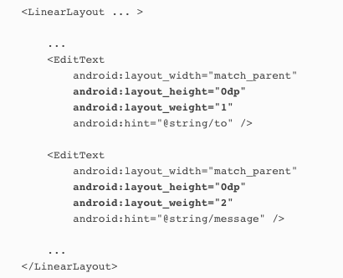
Chap 5 – Linear Layout
Notes:
Suppose we gave the To text field a weight of 1, and the Message text field a weight of 2 like this:

Slide 14
Chap 5 – Linear Layout
android:gravity="top"
Notes:
The next thing we need to do is move the hint text inside the Message text field. At the moment, it’s centered vertically inside the view. We need to change it so that the text appears at the top of the text field. We can achieve this using the android:gravity attribute.
The android:gravity attribute lets you specify how you want to position the contents of a view inside the view—for example, how you want to position text inside a text field. If you want the text inside a view to appear at the top, the following code will do the trick:

Slide 15
Chap 5 – Linear Layout
Notes:
Suppose we gave the To text field a weight of 1, and the Message text field a weight of 2 like this:

Slide 16
android:gravity=“value” | What it does
top | Puts the view’s contents at the top of the view.
bottom | Puts the view’s contents at the bottom of the view.
left | Puts the view’s contents at the left of the view.
right | Puts the view’s contents at the right of the view.
center_vertical | Centers the view’s contents vertically.
center_horizontal | Centers the view’s contents horizontally.
center | Centers the view’s contents vertically and horizontally.
fill_vertical | Make the view’s contents fill the view vertically.
fill_horizontal | Make the view’s contents fill the view horizontally.
fill | Make the view’s contents fill the view.
Notes:
Here are some more of the values you can use with the android:gravity attribute. Add the attribute to your view, and set its value to one of the values below:
android:gravity="value"

Slide 17
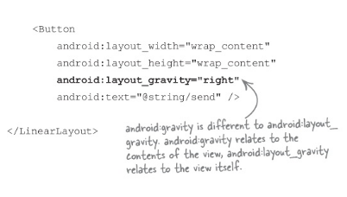
Chap 5 – Linear Layout
Notes:
The android:layout_gravity attribute lets you specify where you want a view in a linear layout to appear in its enclosing space. You can use it to push a view to the right, for instance, or center the view horizontally. To move our button to the right, we’d need to add the following to the button:
android:layout_gravity="right"

Slide 18
android:layout_gravity=“value” | What it does
top, bottom, left, right | Puts the view at the top, bottom, left, or right of its container.
start, end | Puts the view at the start or end of its container.
center_vertical, center_horizontal | Centers the view vertically or horizontally in its container.
center | Centers the view vertically and horizontally in its container.
fill_vertical, fill_horizontal | Grow the view so that it fills its container in a vertical or horizontal direction.
fill | Grow the view so that it fills its container in a vertical and horizontal direction.
top, bottom, left, right | Puts the view at the top, bottom, left, or right of its container.
start, end | Puts the view at the start or end of its container.
center_vertical, center_horizontal | Centers the view vertically or horizontally in its container.
center | Centers the view vertically and horizontally in its container.
Notes:
android:layout_gravity lets you say where you want views to appear in their available space.
android:layout_gravity deals with the placement of the view itself, whereas android:gravity deals with how to display the view contents.

Slide 19
Chap 5 – Linear Layout
Notes:
The final version

Slide 20
Chap 5 – Linear Layout
Views get displayed in the order they appear
Stretch views using weight
Use gravity to specify where a view’s contents appear in a view
Use layout-gravity to specify where a view appears in its enclosing space
Notes:
For the third row we now the button spans two columns, so columnSpan=2, and we put it in row2, column 2 and we also know it should be centered so we use center_horizontal

Slide 21
Chap 5 – Grid Layout
Notes:
GridLayout requires API level 14 or above.If you plan on using a grid layout, make sure your app uses a minimum SDK of API 14.

Slide 22
Chap 5 – Grid Layout
Notes:
You specify how many columns you want the grid layout to have using:
android:columnCount="number"where number is the number of columns. You can also specify a maximum number of rows using:
android:rowCount="number"but in practice you can usually let Android figure this out based on the number of views in the layout. Android will include as many rows as is necessary to display the views.

Slide 23
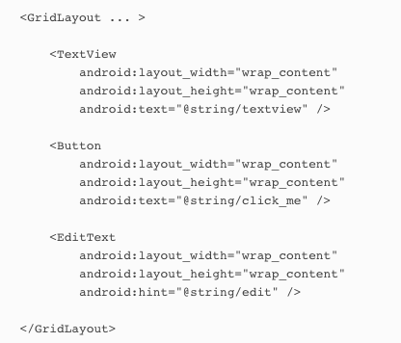
Chap 5 – Grid Layout
Notes:
You can add views to a grid layout in a similar way to how you add views to a linear layout:Just like a linear layout, there’s no need to give your views IDs unless you’re explicitly going to refer to them in your activity code. The views don’t need to refer to each other within the layout, so they don’t need to have IDs for this purpose.
By default, the grid layout positions your views in the order in which they appear in the XML. So if you have a grid layout with two columns, the grid layout will put the first view in the first position, the second view in the second position, and so on.
if you remove one of your views from the layout, it can drastically change the appearance of the layout.

Slide 24
Chap 5 – Grid Layout
Notes:
To see this in action, we’ll create a grid layout that specifies which cells we want views to appear in, and how many columns they should span. The layout is composed of a text view containing the text “To”, an editable text field that contains hint text of “Enter email address”, an editable text field that contains hint text of “Message”, and a button labeled “Send”:
Here’s what we’re going to do
Sketch the user interface, and split it into rows and columns.This will make it easier for us to see how we should construct our layout.
Build up the layout row by row.

Slide 25
Chap 5 – Grid Layout
Notes:
The first thing we’ll do to create our new layout is sketch it out. That way we can see how many rows and columns we need, where each view should be positioned, and how many columns each view should span.

Slide 26
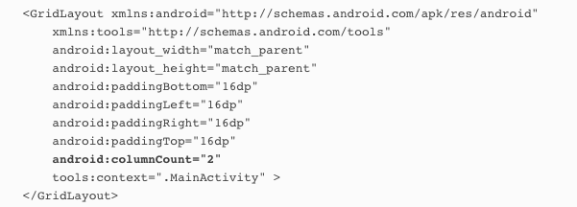
Chap 5 – Grid Layout
Notes:
We can position our views how we want if we use a grid layout with two columns: Now that we have the basic grid layout defined, we can start adding views.

Slide 27
Chap 5 – Grid Layout
Notes:
The first row of the grid layout is composed of a text view in the first column, and an editable text field in the second column. You start by adding the views to the layout: You can use android:gravity and android:layout_gravity attributes with grid layouts.

Slide 28
Chap 5 – Grid Layout
Notes:
We also need to tell it what row and column it should live in using layout_row and layout_column

Slide 29
Chap 5 – Grid Layout
Notes:
The second row of the grid layout is composed of an editable text field that starts in the first column and spans across the second. The view takes up all the available space.To get a view to span multiple columns, you start by specifying which row and column you want the view to start in. We want the view to start in the first column of the second row, so we need to use:android:layout_row="1"android:layout_column="0”
We want our view to go across two columns, and we can do this using the android:layout_columnSpan attribute like this:

Slide 30
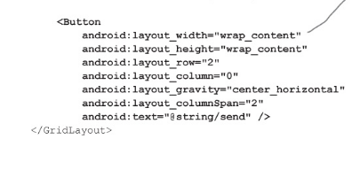
Chap 5 – Grid Layout
Notes:
For the third row we now the button spans two columns, so columnSpan=2, and we put it in row2, column 2 and we also know it should be centered so we use center_horizontal

Slide 31
Chap 5 – Grid Layout
Notes:
For the third row we now the button spans two columns, so columnSpan=2, and we put it in row2, column 2 and we also know it should be centered so we use center_horizontal

Slide 32
Chap 5 – Grid Layout
Specify which row and column each view should start in
Specify how many columns each view should span
Notes:
For the third row we now the button spans two columns, so columnSpan=2, and we put it in row2, column 2 and we also know it should be centered so we use center_horizontal

Slide 33
Chap 5 – GUI components are a type of view
Notes:
all layouts and GUI components are subclasses of the Android View class.
GUI components are all types of views—behind the scenes, they are all subclasses of the android.view.View class.
his means that all of the GUI components you use in your user interface have attributes and behavior in common. They can all be displayed on the screen, for instance, and they can say how tall or wide they should be. Each of the GUI components you use in your user interface take this basic functionality, and extend it.

Slide 34
Chap 5 – Layout type of View called ViewGroup
Notes:
A GUI component is a type of view, an object which takes up space on the screen.A layout is a type of view group, which is a special type of view that can contain other views.

Slide 35
Chap 5 – Getting and Setting Properties
Notes:
Each view is a Java object behind the scenes, and that means you can get and set its properties in your activity code. As an example, you can retrieve the value selected in a spinner or change the text in a text view. The exact properties and methods you can access depend on the type of view.
SIZE AND POSITION
You can specify the width and height of views so that Android knows how big they need to be. You can also say whether any padding is needed around the view.
Once your view has been displayed, you can retrieve the position of the view, and its actual size on the screen.
FOCUS HANDLING
Android handles how the focus moves depending on what the user does. This includes responding to any views that are hidden, removed, or made visible.
EVENT HANDLING AND LISTENERS
Each of your views can respond to events. You can also create listeners so that you can react to things happening in the view. As an example, all views can react to getting or losing the focus, and a button (and all of its subclasses) can react to being clicked.
As a view group is also a type of view, this means that all layouts and GUI components share this common functionality.

Slide 36
Chap 5 – Layout is a hierarchy of Views
Notes:
The layout you define using XML gives you a hierachical tree of views and view groups. As an example, here’s a relative layout containing a button and an editable text field. The relative layout is a view group, and the button and text field are both views. The view group is the view’s parent, and the views are the view group’s children:

Slide 37
Chap 5 – Layout is a hierarchy of Views
Notes:
Behind the scenes, when you build your app, the layout XML is converted to a ViewGroup object containing a tree of Views. In the example above, the button gets translated to a Button object, and the text view gets translated to a TextView object. Button and TextView are both subclasses of View. This is the reason why you can manipulate the views in your layout using Java code. Behind the scenes, all of the views are rendered to Java View objects.

Slide 38
Chap 5 – GUI Components
Text view
Edit Text
Button
Toggle Button
Switch
Check Boxes
Radio Buttons
Spinner
Image Views
Image Buttons
Scroll Views
Toasts
Notes:
Let’s look at the most common GUI components. You’ve already seen some of these, but we’ll review them anyway. We won’t show you the whole API for each of these—just selected highlights to get you started.

Slide 39
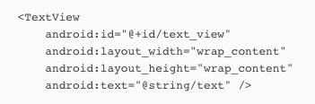
Chap 5 – Text View
Notes:
For each GUI component we’re going to show it, show how it relates to the android view, show how to define it in the layout file and show to use it in an activity
Used for displaying text (whoo hoo)
You define a text view in your layout using the <TextView> element.
You use android:text to say what text you want it to display, usually by using a string resource:
The TextView API includes many attributes to control the text view’s appearance, such as the text size. To change the text size, you use the android:textSize attribute like this:android:textSize="14sp"You specify the text size using scale-independent pixels (sp). Scale-independent pixels take into account whether users want to use large fonts on their devices. A text size of 14sp will be physically larger on a device configured to use large fonts than on a device configured to use small fonts.
The definite guide is https://developer.android.com/reference/android/widget/TextView.html – show it
USING IT IN YOUR ACTIVITY CODE
You can change the text displayed in your text view using code like this:

Slide 40
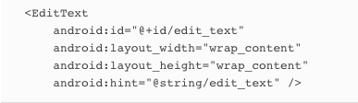
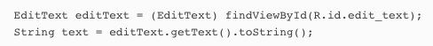
Chap 5 – Edit Text
Notes:
Allows you to edit text
You define an editable text view in XML using the <EditText> element. You use theandroid:hint attribute to give a hint to the user as to how to fill it in.
You can use the android:inputType attribute to define what type of data you’re expecting the user to enter so that Android can help them.
As an example, if you’re expecting the user to enter numbers, you can use android:inputType="number"to provide them with a number keypad.
Using it in your activity codeYou can retrieve the text entered in an editable text view like this:

Slide 41
android:input_Type=“value” | What it does
phone | Provides a phone number keypad
textPassword | Displays a text entry keypad, and your input is concealed.
textCapSentences | Capitalizes the first word of a sentence.
textAutoCorrect | Automatically corrects the text being input.
Notes:
Some more examples of input type for the edit text component

Slide 42
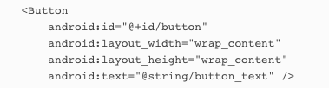
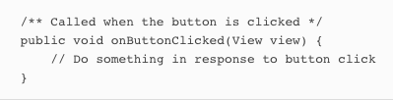
Chap 5 – Button
Notes:
Usually used to make your app do something when the button’s clicked.
Defining it in XMLYou define a button in XML using the <Button> element. You use the android:text attribute to say what text you want the button to display:
Using it in your activity codeYou get the button to respond to the user clicking it by using the android:onClick attribute in the layout XML, and setting it to the name of the method you want to call in your activity code:android:onClick="onButtonClicked"
You then define the method in your activity like this:

Slide 43
Chap 5 – Toggle Button
Notes:
A toggle button allows you to choose between two states by clicking a button.

Slide 44
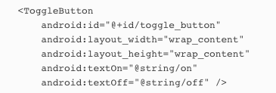
Chap 5 – Toggle Button
Notes:
Defining it in XML
You define a toggle button in XML using the <ToggleButton> element.
You use the android:textOn and android:textOff attributes to say what text you want the button to display depending on the state of the button:
Using it in your activity code
You get the toggle button to respond to the user clicking it by using the android:onClick attribute in the layout XML. You give it the name of the method you want to call in your activity code:

Slide 45
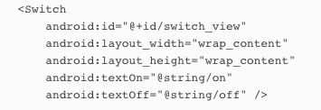
Chap 5 – Switch
Notes:
A switch is a slider control that acts in the same way as a toggle button. If you want to use a switch in your app, make sure it uses a minimum SDK of API level 14.
Defining it in XML
You define a toggle button in XML using the <Switch> element. You use the android:textOn and android:textOff attributes to say what text you want the switch to display depending on the state of the switch:
Using it in your activity code
You get the switch to respond to the user clicking it by using the android:onClick attribute in the layout XML, and setting it to the name of the method you want to call in your activity code: android:onClick="onSwitchClicked"

Slide 46
Chap 5 – Check Boxes
Notes:
Check boxes let you display multiple options to users. They can then select whichever options they want. Each of the checkboxes can be checked or unchecked independently of any others.
Defining them in XML
You define each checkbox in XML using the <CheckBox> element. You use the android:text attribute to display text for each option:
Just like buttons, you can respond to the user clicking a checkbox by using the android:onClick attribute in the layout XML, and setting it to the name of the method you want to call in your activity code:

Slide 47
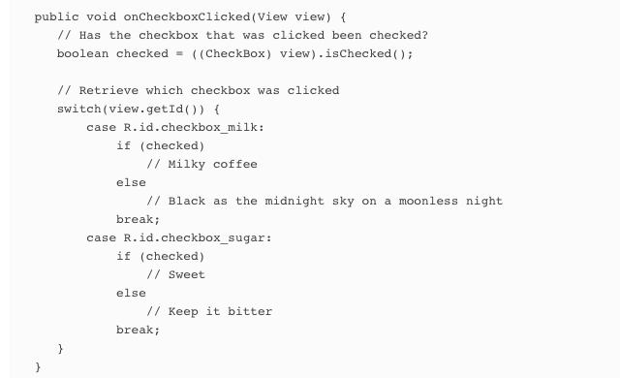
Chap 5 – Check Boxes
Notes:
Using them in your activity code
You can find whether a particular checkbox is checked using the isChecked() method. It returns true if the checkbox is checked:
You then define the method in your activity like this:

Slide 48
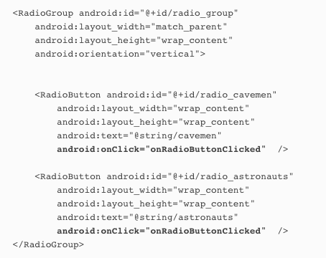
Chap 5 – Radio Buttons
Notes:
Use Radio Buttons to restrict the user to just one option
DEFINING THEM IN XML
You start by defining a radio group, a special type of view group, using the <RadioGroup> tag. Within this, you then define individual radio buttons using the <RadioButton> tag:
The radio group containing the radio buttons is a subclass of LinearLayout. You can use the same attributes with a radio group as you can with a linear layout.
For example you can choose to display the radio buttons in a horizontal or vertical list
You can respond to the user clicking a radio button by using the android:onClick attribute in the layout XML, and setting it to the name of the method you want to call in your activity code:

Slide 49
Chap 5 – Radio Buttons
Notes:
Use Radio Buttons to restrict the user to just one option
DEFINING THEM IN XML
You start by defining a radio group, a special type of view group, using the <RadioGroup> tag. Within this, you then define individual radio buttons using the <RadioButton> tag:
The radio group containing the radio buttons is a subclass of LinearLayout. You can use the same attributes with a radio group as you can with a linear layout.
For example you can choose to display the radio buttons in a horizontal or vertical list
You can respond to the user clicking a radio button by using the android:onClick attribute in the layout XML, and setting it to the name of the method you want to call in your activity code:

Slide 50
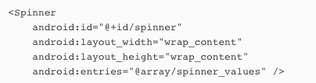
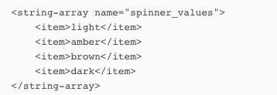
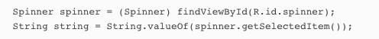
Chap 5 – Spinner
Notes:
Spinner
As you’ve already seen, a spinner gives you a drop-down list of values from which only one can be selected.
Defining it in XML
You define a spinner in XML using the <Spinner> element. You add a static array of entries to the spinner by using the android:entries attribute and setting it to an array of strings.
You can also add an array of strings to strings.xml in the res/values file
Using it in your activity code
You can get the value of the currently selected item by using the getSelectedItem() method and converting it to a String:

Slide 51
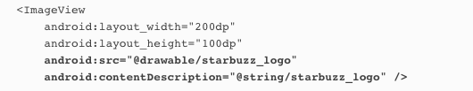
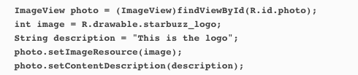
Chap 5 – Image
Notes:
Adding an image to your project
You first need to add an image file to your project as a drawable resource. If you expand the app/src/main/res folder in your project, you should see that there’s a folder called drawable. This is the default location for image resources. To add an image file to this folder, you simply drag the image file to it.If you want, you can use different image files depending on the screen density of the device. This means you can display higher-resolution images on higher-density screens, and lower-resolution images on lower-density screens. To do this, you create different drawable folders in app/ src/main/res for the different screen densities. The name of the folder relates to the screen density of the device:
Defining in XML
You define an image view in XML using the <ImageView> element. You use the android:src attribute to specify what image you want to display. You use the android:contentDescription attribute to add a string description of the image so that your app is more accessible:
The android:src attribute takes a value of the form "@drawable/ image_name", where image_name is the name of the image (without its extension). Image resources are prefixed with @drawable. @drawable tells Android that it’s an image resource located in one or more of the drawable folders.
Using it in your activity code
You can set the image source and description in your activity code using the setImageResource() and setContentDescription() methods:
This code looks for the image resource called starbuzz_logo in the drawable* folders, and sets it as the source of an image view with an ID of photo. When you need to refer to an image resource in your activity code, you use R.drawable.image_name where image_name is the name of the image (without its extension)

Slide 52
Folder | Device Type
android-ldpi | Low-density screens, around 120 dpi.
android-mdpi | Medium-density screens, around 160 dpi.
android-hdpi | High-density screens, around 240 dpi.
android-xhdpi | Extra-high-density screens, around 320 dpi.
android-xxhdpi | Extra-extra-high-density screens, around 480 dpi.
android-xxxhdpi | Extra-extra-extra high-density screens, around 640 dpi.
Notes:
You then put different resolution images in each of the drawable* folders, making sure that each of the image files has the same name. Android decides which image to use at runtime, depending on the screen density of the device it’s running on. As an example, if the device has an extra high density screen, it will use the image located in the drawable-xhdpi folder.If an image is added to just one of the folders, Android will use the same image file for all devices. It’s common to use the drawable folder for this purpose.

Slide 53
Chap 5 – Image
Notes:
you can also display images on buttons.
Displaying text and an image on a buttonTo display text on a button with an image to the right of it, use the android:drawableRight attribute and specify the image to be used:
If you want to display the image on the left, use the android:drawableLeft attribute:
The android:drawableBottom attribute displays the image underneath the text:
The android:drawableTop attribute displays the image above the text:

Slide 54
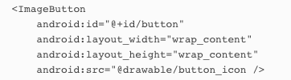
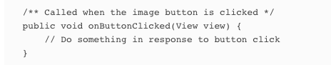
Chap 5 – Image Button
Notes:
An image button is just like a button, except it contains an image and no text.
Defining it in XML
You define an image button in XML using the <ImageButton> element. You use the android:src attribute to say what image you want the image button to display:
Using it in your activity code
You get the image button to respond to the user clicking it by using the android:onClick attribute in the layout XML, and setting it to the name of the method you want to call in your activity code: android:onClick="onButtonClicked”

Slide 55
Chap 5 – Scroll Views
Notes:
Scroll views
If you add lots of views to your layouts, you may have problems on devices with smaller screens—most layouts don’t come with scrollbars to allow you to scroll down the page.
As an example, when we added seven large buttons to a linear layout, we couldn’t see all of them.

Slide 56
Chap 5 – Scroll Views
Notes:
To add a vertical scrollbar to your layout, you surround your existing layout with a <ScrollView> element like this:

Slide 57
Chap 5 – Scroll Views
Notes:
To add a horizontal scrollbar to your layout, wrap your existing layout inside a <HorizontalScrollView> element instead.

Slide 58
Chap 5 – Toasts
Notes:
Toasts
There’s one final widget we want to show you in this chapter: a toast.
A toast is a simple pop-up message you can display on the screen.
Toasts are purely informative, as the user can’t interact with them. While a toast is displayed, the activity stays visible and interactive. The toast automatically disappears when it times out

Slide 59
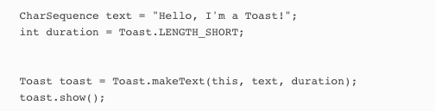
Chap 5 – Toasts
Notes:
Using it in your activity code
You create a toast using activity code only. You can’t define one in your layout. To create a toast, you call the Toast.makeText() method, and pass it three parameters: a Context (usually this for the current activity), a CharSequence that’s the message you want to display, and an int duration. Once you’ve created the toast, you call its show() method to display it.Here’s the code you would use to create a toast that appears on screen for a short duration:

Slide 60
Summary
GUI components are all types of view. They are all subclasses of the android.view.Viewclass.
All layouts are subclasses of the android.view.ViewGroup class. A view group is a type of view that can contain multiple views.
The layout XML file gets converted to a ViewGroup containing a hierarchical tree of views.
A relative layout displays child views relative to other views, or relative to the parent layout.
A linear layout lists views either horizontally or vertically. You specify the direction using theandroid:orientation attribute.
A grid layout divides the screen into a grid of cells so that you can specify which cell (or cells) each view should occupy. Use android:columnCount to say how many columns there should be. Use android:layout_row and android:layout_column to say which cell you want each view to appear in. Use android:layout_columnSpan to say how many columns the view should spread across.
Use android:padding* attributes to specify how much padding you want there to be around a view.
Use android:layout_weight in a linear layout if you want a view to use up extra space in the layout.

Slide 61
Summary
android:layout_gravity lets you say where you want views to appear in their available space.
android:gravity lets you say where you want the contents to appear inside the view.
<ToggleButton> defines a toggle button which allows you to choose between two states by clicking a button.
<Switch> defines a switch control that behaves in the same way as a toggle button. It requires API level 14 or above.
<CheckBox> defines a checkbox.
To define a group of radio buttons, first use <RadioGroup> to define the radio group. Then put individual radio buttons in the radio group using <RadioButton>.
Use <ImageView> to display an image.
<ImageButton> defines a button with no text, just an image.
Add scrollbars using <ScrollView> or <HorizontalScrollView>.
A Toast is a pop-up message.

Slide 62
Assignment
Chapter 3 HFAD – Get Intent code example working (due Thursday)
Read Chapter 5

